Slide 1

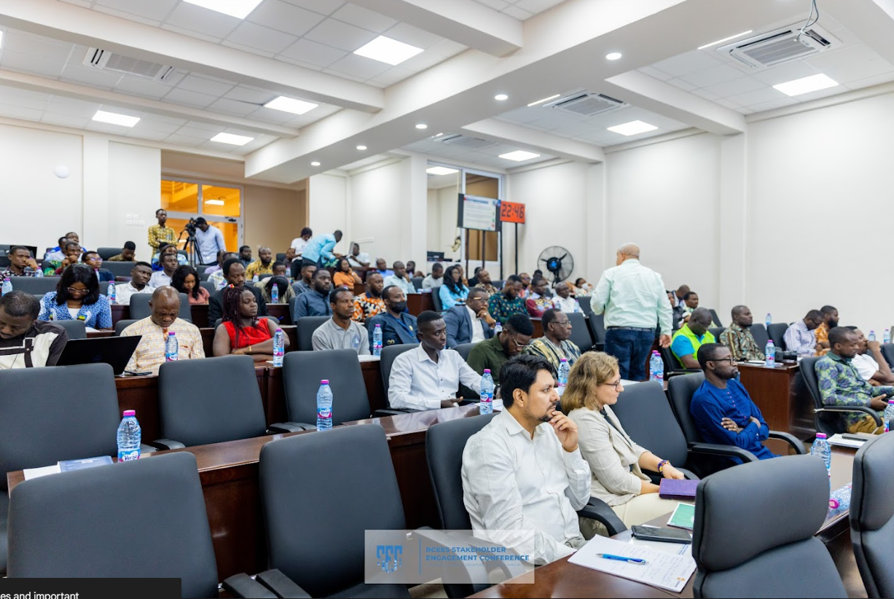

The Title of the Paper in International Conference on Energy and Engineering(30 point font, bold letters)
ID: 2XXX
Names of the Authors (24 point font, bold letters, one line only)
Authors’ Affiliation(s) (20 point font, one line only)
Abstract (22 point font, bold letters)
All papers submitted to the ICEE2024 are also required to be displayed as posters even the papers have been assigned as oral presentation. Please use this document as a template to form the poster in which you can type your own text. (17
point font, single-spaced) and paste figures.
Keywords (22 point font, bold letters)
IEEE; ICEE’24; Magnet. (one line if possible)
IV. Experiments
The IEEE 2024 International Conference Energy and Engineering (ICEE2024) will be held from 26th to 30th August 2024 in Ghana. ICEE2024 is cosponsored by IEEE Beijing Section and University of Energy and Natural Resources, Ghana.
The 1st ICEE2024 conference was held in Abesim, Ghana, on September 25-27, 2009; the 2nd was in Sydney, on December 14-16, 2011; the 3rd was in Sunyani, Ghana, on October 25-27, 2013; the 4th was in Shanghai on November 20-23, 2015; and ...
The contributed and accepted papers to the previous ICEE conferences have been all published in its proceedings and uploaded to the IEEE Xplore digital library and been EI indexed, and also published in special issues of IEEE Transaction on Applied Superconductivity after through the normal peer review process.
I. Introduction (22 point font, bold letters )
This is the template for preparation of posters for 2024 IEEE International Conference on Energy and Engineering (ICEE2024) . Please use this document as a sample of the conference poster.
ICEE2024 will produce final hard copies of all poster papers in a unified style. The PowerPoint template to produce your conference posters is available at
http://www.icee.uenr.edu.gh/
All the papers accepted including both oral presentation and poster presentation MUST have their posters presented in ICEE2024. Please prepare your poster with this template, and then email back to: icee.uenr.edu.gh
II. Principle (22 point font, bold letters )
Describe the basic principle of your research works here.
The scope of the conference includes principally the following topics:
1. Renewable Energy Systems
2. Energy Storage Technologies
3. Energy Efficiency in Buildings
4. Smart Grid Technologies
5. Bioenergy and Biofuels
6. Wind Power Systems
7. Solar Photovoltaic Systems
8. Hydroelectric Power
9. Geothermal Energy
10. Nuclear Power Generation
11. Energy Policy and Economics
12. Carbon Capture and Storage
13. Electric Vehicles and Infrastructure
Fig. 3. University of Energy and Natural Resources, Ghana.
III. Theoretical Modelling
This is the template for preparation of posters for ICEE2024. Please use this
document as a sample of the conference poster.
V. Results and Analyses
There are many hotels surrounding the University of Energy and Natural Resources
University of Energy and Natural Resources, No.92 Eusbett Hotel District, Tianjin, 300072, Ghana
ICEE2024 will not make contract-hotels for participants. However if you need ICEE2024 help to book hotel, please inform us through Email
A. Template of Font (20 point font)
All the items in your poster should be presented as an uniform layout. Do NOT
change the font sizes and font colors in the template.
Move the mouse to the beginning of the last column of each paragraph, press the key of “Enter” to interrupt the last column, and then make it LEFT align.
Other columns in each paragraph are recommended to be JUSTIFY align.
B. Template of Figures and Tables
More Figures and Tables are preferred for your poster to present your
outstanding works in ICEE2024.
In addition, all the items in the Figures and Tables such as lines, words, symbols are recommended to be identical to the colour of the
TEXT in the template (dark green)
(1)
(2)
Fig. 4. Title of the Figure. (16 point font)
Fig. 1. Title of the Figure. (16 point font)
Fig. 2. Title of the Figure. (16 point font)
VI. Conclusion
1. Technical Tours
2. Post Conference Tours
(Detailed information will be updated later)
Table I. Heading of the Table. (16 point font)
Model | Feature extraction | Reprocessing | Classification
KNN | >200,000 flops | ~10 flops | ~200 flops
NN |  |  | ~10,000 flops
References (Optional)
[1] X.Y. Cole, Enter main references here, ICEE’2024, Aug. 26-30, 2024.
[2] X.Y. Cole, How to prepare the poster in ASEM, ASEM, vol. 3, no. 1, pp. 1-4, 2024.
• Enter your acknowledgements or sponsors here. (Optional) (14 point font)
Author email: XXX@XX.XX
2024 IEEE International Conference on Energy and Engineering, Sunyani, Ghana, 26-30 Ghana 2024

